Slide 1
Introduction to GCSDK
SHAKTI Group | CSE Dept | PS-CDISHA - RISE Lab | IIT Madras
RISE LAB
IIT - Madras

Slide 2
Preview of the Session
1. GC2025 SoC’s
2. Introduction to GCSDK
3. GCSDK Framework
4. Compiling and Executing ‘Hello World’ Program
5. Adding new Application to GCSDK
6. Adding new Peripheral to GCSDK
7. Adding a Project to GCSDK
8. Q & A

Slide 3
GC2025 SHAKTI SoC’s

Slide 4
GC2025 SHAKTI SoC
1. GANGA SoC
Ganga is a 64-bit RISC-V SoC based on the SHAKTI C-Class core with a 6-stage pipeline, compliant with the RV64IMACSU instruction set.
2. YAMUNA SoC
Yamuna is a 32-bit RISC-V SoC based on the SHAKTI C-Class core with a 6-stage pipeline, compliant with the RV32IMAC instruction set.

Slide 5
Introduction to GCSDK

Slide 6
Introduction to GCSDK
Software Development Kit (SDK) provided to participants in GC2025.
Clean separation between boot, drivers, core and application layers.
Single place for bare-metal application development, projects and benchmarks.
Driver support for PWM, SPI, PLIC, CLINT, UART, I2C, GPIO, GPTimer and XADC.
Standalone and Debug mode supported.

Slide 7

Application to Output flow
After the application is compiled , it is important to understand the flow of how the binary is executed. Tools like openocd and riscv-gdb helps in executing the compiled binary
1. Openocd (Open On-Chip Debugger) -
  Tool that lets the host interact with target hardware.
  Act as bridge between host and target hardware.

Slide 8
Application to Output flow
2. GDB (GNU Debugger) -
Debugging tool designed for RISC V architecture.
Program that helps to see what the code is doing inside the processor - while it runs, stops, crashes, or behaves weirdly.

Slide 9
Understanding Framework of GCSDK

Slide 10
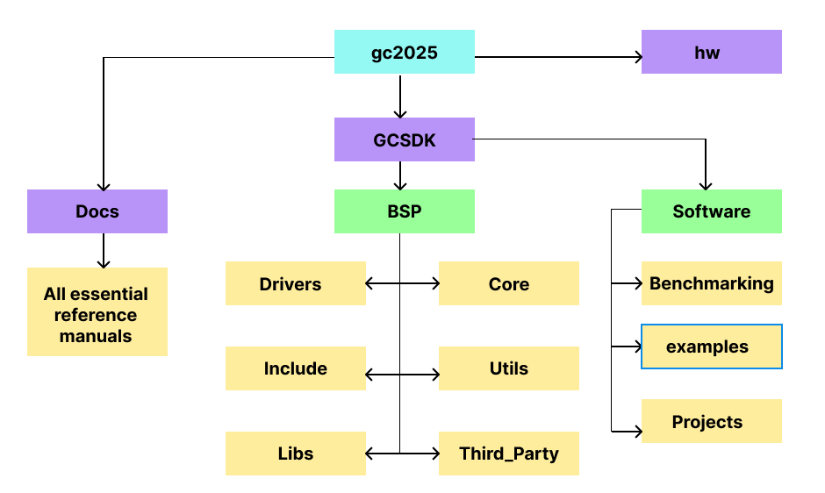
GCSDK Framework
https://gitlab.com/shaktiproject/gc2025.git

Slide 11
BSP - Board Support Package
The BSP is layer above the hardware. It consists of
Driver files for various protocols (peripherals).
Header files for driver files.
Essential functions and reusable code like ‘printf’ and multi-level logging for debugging.
Startup code , trap handler , memory initialisation.
Files required for booting
Platform dependent definitions tailored to each SoC.

Slide 12
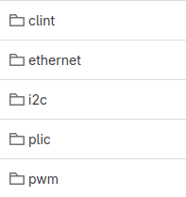
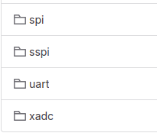
Drivers
Drivers are for all supported peripherals (protocols).
Inside each driver file is a set of software constructs (functions / API ).
Executes a particular task in hardware.
Called by the application code / project.

Slide 13
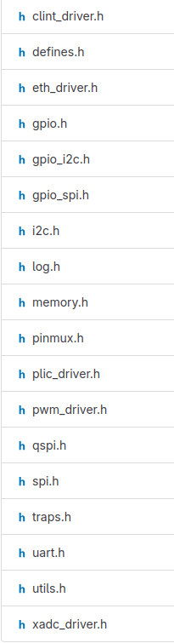
Include
Header files for all the peripheral drivers.
Generic But Board specific.
Peripheral registers are mapped as arrays.
Instance of arrays used to access the registers.
Macros for bit level description of the registers.

Slide 14
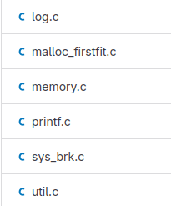
Lib
Utilities are defined as APIs with definitions and implementations. e.g Printf, multi level log prints, delay loops, string operations, etc.
Called repeatedly in the application codes. e.g. Print library, delay_loop.

Slide 15
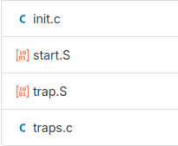
Core
Trap Handling initialisations & calling the main function.
Register initialisation, Section initialisation like (stack, text, global, data, etc.)
Pushing the register values into Stack, Call ISR, Pop the register values.
Find the cause for the trap and jump to the Handler
Core has implementation which
Initialises memory.
Trap handler functions to handle exceptions and interrupts.
Startup file which initialises the RISC-V Registers.
Handlers for different privilege levels.

Slide 16
Third Party
Board specific address mapping (platform.h).
Configuration files to be used for debugging (ftdi.cfg).
Linker for various sections of the code.
Support for backward compatibility.
Ganga
Yamuna

Slide 17
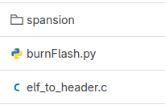
Utils
Board SPI or External SPI can be used for uploading the application code into flash.
Application code to be flashed is converted into a header file before uploading.
Has the required python scripts required to flash the application code.

Slide 18
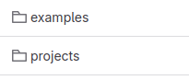
Software
Example driver codes for peripherals.
Application Project with many drivers.
“Examples” consist of Application code targeted use the functionality of individual peripheral.
“Projects” consists of Application code involving multiple peripherals.
“BenchMarks” It is a set of Standard works , used to evaluate performance of the Core.

Slide 19
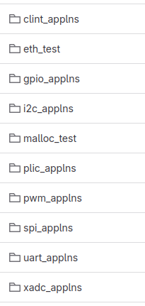
Examples
Simple code to show how the driver API can be called.
Application code which uses only one peripheral (driver) as main one.
Has multiple application code for each driver.

Slide 20
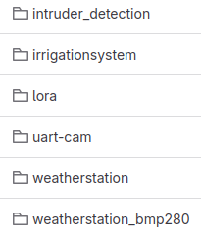
Projects
Integrates more than one peripheral driver.
Application code which uses more than one peripheral.
Focus here is to show how multiple drivers can be integrated into a single top file and used.

Slide 21
Demo : Compile and Execute “Hello World” Program

Slide 22
Prerequisite
Vivado - to program the FPGA.
OpenOCD - to configure the host as server.
RISCV-GNU-TOOLCHAIN - connect the core (SoC) as client to server and accesses the core/SoC.
GTKTerm - for viewing the console prints.
Refer the “tool setup manual” in GCSDK/Docs

Slide 23
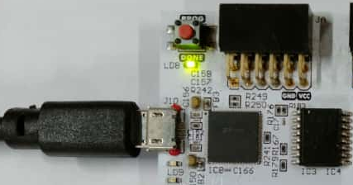
Program the FPGA
As demonstrated in previous session , program the FPGA with the bitstream / mcs using Vivado
Refer the “Bitstream/MCS Generation and FPGA Target Configuration” manual in GCSDK/Docs
After Programming the board

Slide 24
Compile the Application
Make sure the working directory is /GCSDK
Execute the following command
The <target_soc> can either be ‘ganga’ or ‘yamuna’.
*please note <target_soc> is case sensitive
Refer the “Shakti SDK ” user manual in GCSDK/Docs
make software PROGRAM=hello TARGET=<target_soc>

Slide 25
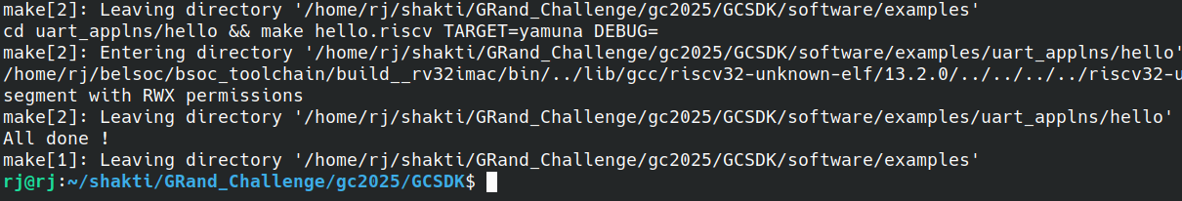

Slide 26
Connecting Openocd
Make sure the working directory is /GCSDK
Execute the following command
The <target_soc> can either be ‘ganga’ or ‘yamuna’.
*please note <target_soc> is case sensitive
Refer the “Shakti SDK ” user manual in GCSDK/Docs
cd bsp/third_party/<Target_SoC> sudo ./openocd -f ftdi.cfg

Slide 27
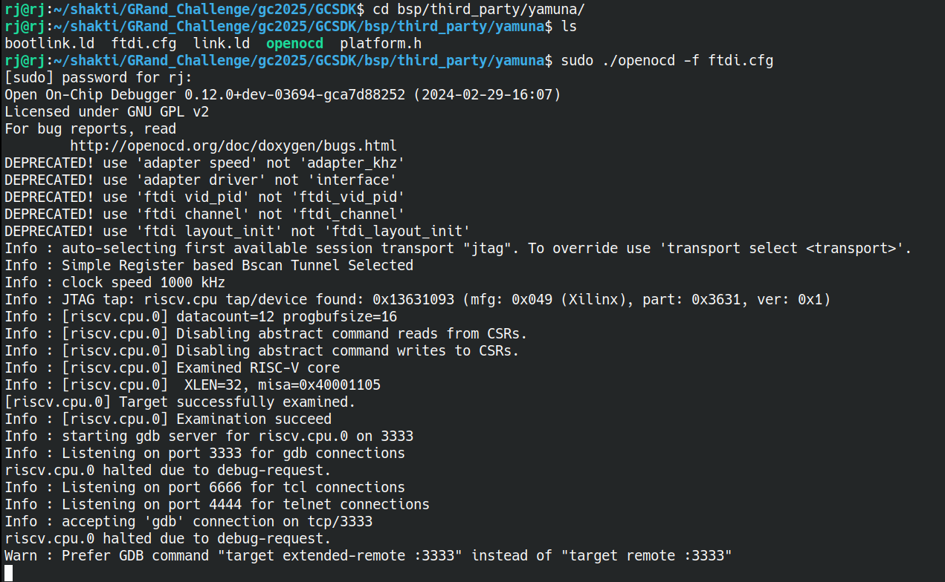

Slide 28
Connecting Debugger
Make sure the working directory is /GCSDK
Execute the following command
*please note XLEN depends on the toolchain you have installed
RV64 : XLEN = 64 ; RV32 : XLEN = 32
Refer the “Shakti SDK ” user manual in GCSDK/Docs
riscv(XLEN)-unknown-elf-gdb -x gdb.script

Slide 29
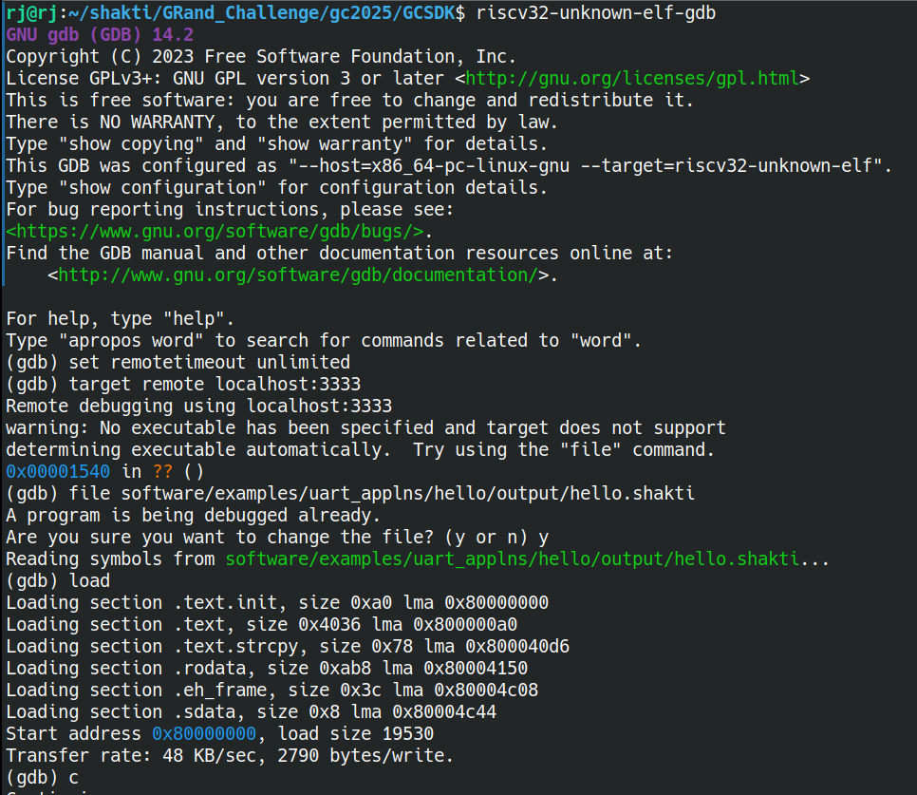

Slide 30
Viewing the Output
Make sure the working directory is /GCSDK
Execute the following command
Refer the “Shakti SDK ” user manual in GCSDK/Docs
sudo gtkterm

Slide 31
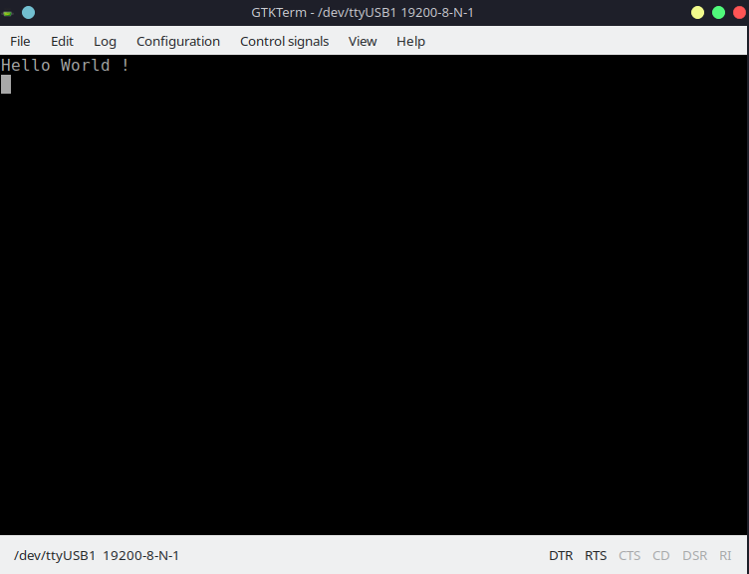

Slide 32
Adding new Application to GCSDK

Slide 33
Makefile
To compile programs more efficiently the GNU’s MAKE utility is used. The make utility uses the Makefile to compile programs from source code. The output generated by the MAKE utility is in ELF format (with extension as “shakti”).

Slide 34
Steps to add a new Application to GCSDK
Create a folder inside the target application
example : new application - my_first_code , (it is a uart based application)

Slide 36
Steps to add a new Application to GCSDK
Create a file with the same name of folder inside the newly created folder.
example : my_first_code.c

Slide 38
Steps to add a new Application to GCSDK
Add a makefile to the newly created folder
Re-use existing Makefile file from another folder within the same application
Write your own custom Makefile.

Slide 40
Steps to add a new Application to GCSDK
Open the Makefile in the ‘example’ directory.
Add an new ‘ifeq’ block
Provide path and file name
Add and ‘endif’ block to close the ‘ifeq’ block

Slide 42
Steps to add a new Application to GCSDK
Make sure the working directory is /GCSDK
Execute the following command
The <target_soc> can either be ‘Ganga’ or ‘Yamuna’.
*please note <target_soc> is case sensitive
make software PROGRAM=my_first_code TARGET=<target_soc>

Slide 44
Adding New Peripheral to GCSDK

Slide 45
Adding New Peripheral Details
In the directory /bsp/third_party/<target_SoC> modify “Platform.h” to :
Add new peripheral base address.
Peripheral offset.
Peripheral count.

Slide 46
Adding New Peripheral Registers Details
In the directory /bsp/include add “<new_peripheral>.h” to :
Add new peripheral registers in structures.
Be careful in adding variable length registers.
All registers are uniformly placed with 32 bit offset.

Slide 47
Initializing New Peripheral Address
Inside /bsp/driver/ , create new folder <new_peripheral> for the newly added peripheral
Inside the newly created folder , create <new_driver>.c file.
Initialises the base address for a particular set of peripheral.
Peripheral instance with array index can be used to point to the registers of the peripheral.

Slide 49
Add New Driver to Makefile
In /examples ‘Makefile’ add the path to the new driver under appropriate TARGET in ‘compile’ section
Add the path to the object file to new driver under appropriate TARGET in ‘build’ section

Slide 50
Adding and Compiling New Project to GCSDK

Slide 51
Add New Project

Slide 52
Compiling Newly added Project

Slide 53
References
Shakti Documentation: https://shakti.org.in/documentation.html
Shakti Blogs: https://blogshakti.org.in/
Shakti FPGA files: https://gitlab.com/shaktiproject/sp2020
Shakti SDK: https://gitlab.com/shaktiproject/software/shakti-sdk
Shakti on Arduino: https://blogshakti.org.in/how-to-print-hello-world-on-shakti-using-arduino-ide/
Linux on Shakti: https://gitlab.com/shaktiproject/software/linux-on-shakti
Platform IO: https://registry.platformio.org/platforms/platformio/shakti
Shakti cores: https://gitlab.com/shaktiproject/cores
Shakti peripherals: https://gitlab.com/shaktiproject/uncore/devices

Slide 54
Thank you

